Slide 1
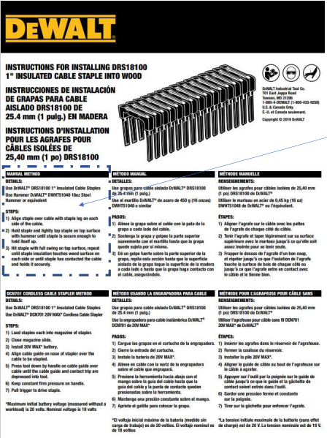
Details:
Use DEWALT® DRS18100 1" Insulated Cable Staples Use Hammer DeWALT® DWHT51048 16oz Steel Hammer or equivalent
STEPS:
1) Align staple over cable with staple leg on each side of the cable. For MC cable, ensure staple is also aligned over a valley in the jacket.
2) Hold staple and lightly tap staple on top surface with hammer until staple is secure enough to hold itself up.
3) Staple must be driven perpendicular to the material it’s being inserted into. Hit staple with full swing on top surface, repeat until staple insulation touches wood surface on each side or until staple has contacted the cable and holds it securely.
4) For 10/4 MC cable only, steps 1-3 must be repeated adding a second staple to each connection point. Staple must be within ½” (13mm) of the first inserted staple.

Slide 2
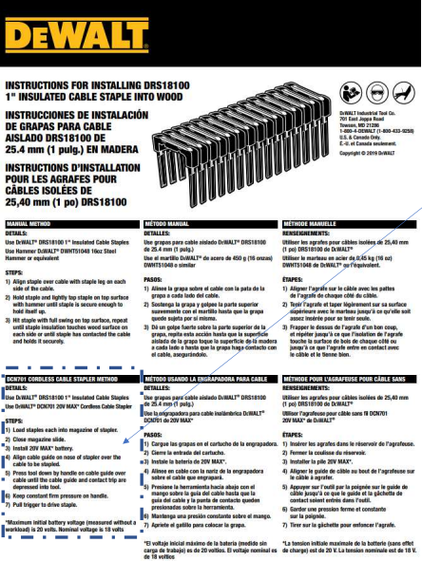
DETAILS:
Use DEWALT® DRS18100 1" Insulated Cable Staples Use DeWALT® DCN701 20V MAX* Cordless Cable Stapler
STEPS:
1) Load staples each into magazine of stapler.
2) Close magazine slide.
3) Install 20V MAX* battery.
4) Align cable guide on nose of stapler over the cable to be stapled. For MC cable, ensure staple is aligned over a valley in the jacket. For NMD90 combinations of 14-3/14-3 and 14-3/12-3, cables must be configured side by side in the cable guide.
5) Press tool down by handle on cable guide over cable until the cable guide and contact trip are depressed into tool.
6) Keep constant firm pressure on handle while maintaining perpendicularity to the material being driven into.
7) Pull trigger to drive staple.
8) For 10/4 MC cable only, steps 4-7 must be repeated adding a second staple to each connection point. Staple must be within ½” (13mm) of the first inserted staple.

